Slide 1


Team 8
Colin Whitcomb
Gabe Sucich
Jen Jayme
Version 1 July 2020

Slide 2
Healthy choices for teens, gamified.
Introduction
Version 1 July 2020
Jen Jayme

Slide 3
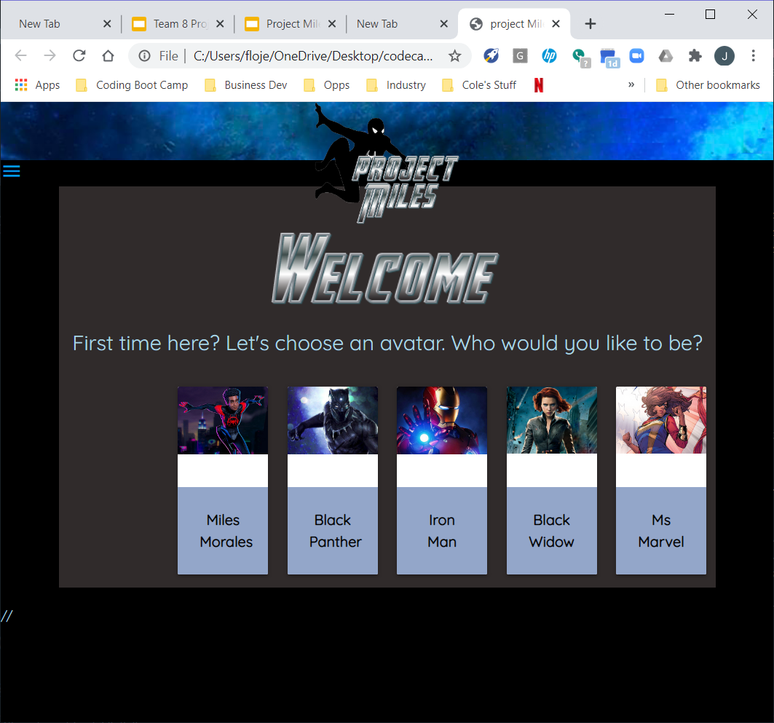
General Layout
Users start by choosing a superhero as their avatar...

Slide 4
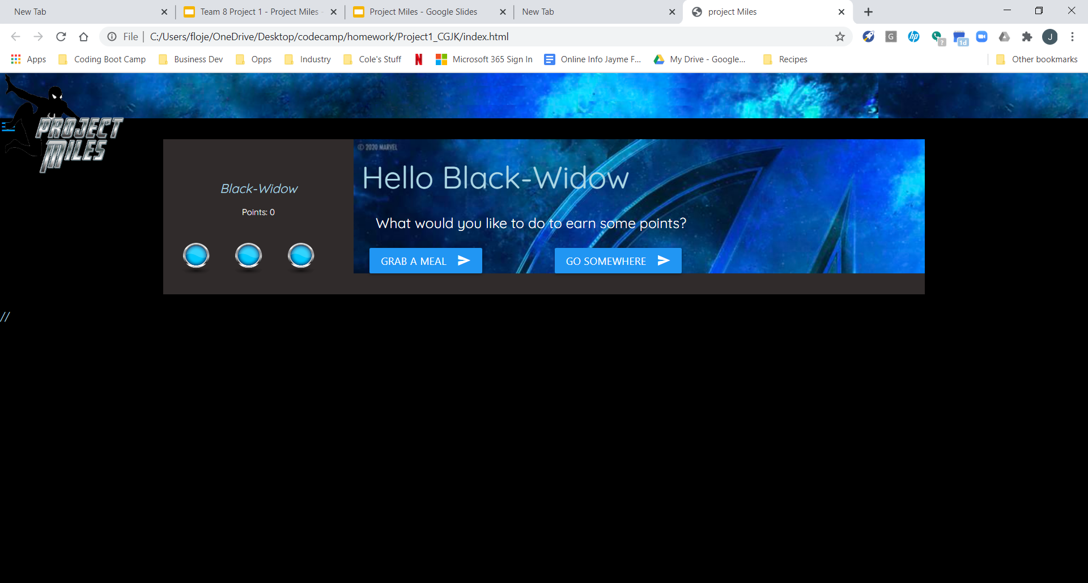
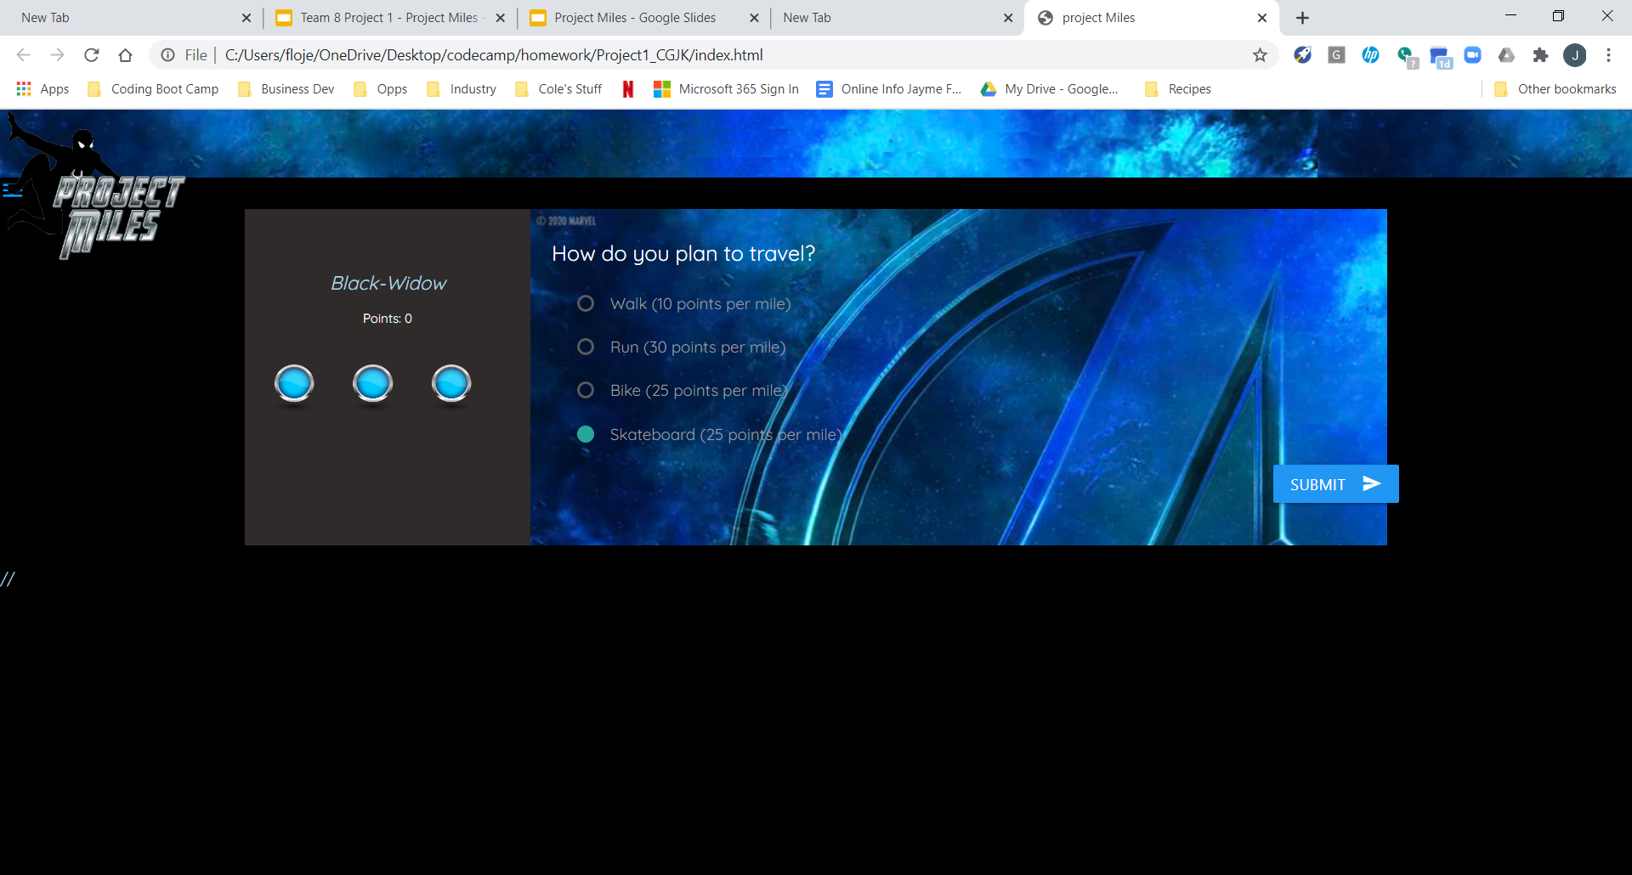
General Layout
...then turn their real-life activities into gaming choices….

Slide 5
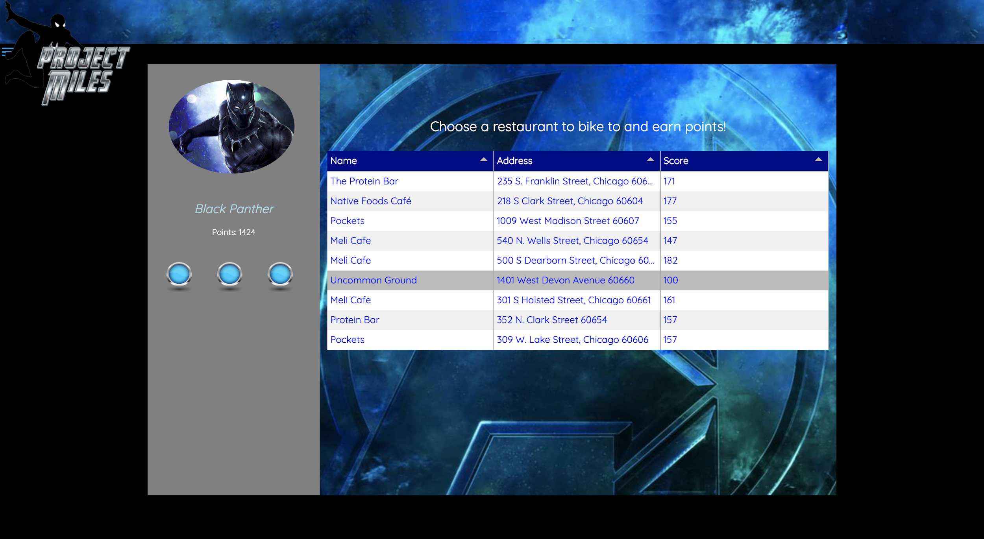
General Layout
...and earn points by eating a healthy meal or getting exercise.

Slide 6

Why Make It?
According to the CDC:
Obesity affects nearly 1 in every 5 US children and adolescents - about 13.7 youth in our country are considered “obese.”
The number of young people that commit suicide has been increasing every year since the 1990’s.
Experts say teens today face more pressures at home and school, worry about family financial issues, and use more alcohol and drugs.
Today’s teens are more overweight, depressed and anxious than in previous generations.

Slide 7

Why Make It?
According to the National Institutes of Health Games for Health Journal:
But video games are increasingly proving an educational tool and effective intervention to modify health behaviors in children and adolescents.
Superheroes are popular among teens and can serve as positive role models.
The Marvel Universe is enjoying unprecedented popularity due to the recent blockbuster movie series.
But they love games and superheroes.
There are not many health apps out there targeted to teens.

Slide 8

Meet Miles.
This fellow inspired our name. He’s an afro-latino teenage character from the Marvel Universe who followed Peter Parker as “the black Spiderman.” He was featured in the recent Academy-Award-winning animated film “Into the SpiderVerse.”
His last name - Miles - is a play on the fact that users can earn points by traveling to their common destinations, and we think he serves as a role model.

Slide 9
Our Users, Their Journey
and Our Journey
Colin Whitcomb

Slide 10



Meet Brandon.
I don’t really like to exercise exactly, but I don’t mind if I get exercise while I’m getting somewhere I have to go anyway…
“I want to know how far away something is so I know if I can walk that far or if I should ride my bike instead.”
Earn Points for Biking to School

Slide 11

Meet Nicole.
My friends and I go out to eat after school a lot. We want to eat healthy but we usually go to the first, closest place we can think of and order french fries. We might try new places if we had a fun way to find healthy meals nearby...
“I want to see restaurant options in my area so that I can choose the location with healthier choices.”
Earn Points for Eating Healthy

Slide 12
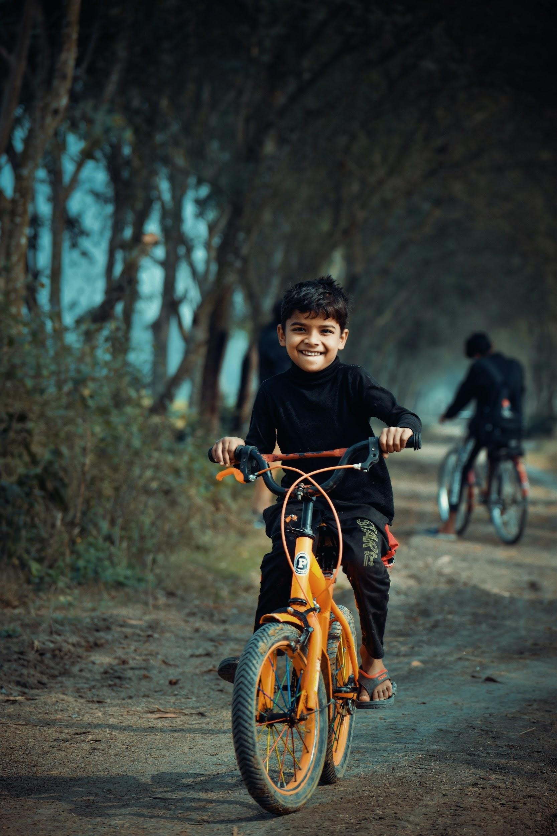
Meet Sam
I hang out at my friends’ house after school all the time. I usually get a ride from my mom, but I guess I could ride my bike or skateboard...
“I really love games. Project Miles makes exercising fun!”
Earn Points for Getting From Place To Place

Slide 13
Design Process
Formulate Concept
Formulate Plan
Build
BRAINSTORM
RESEARCH APIs
DECIDE IDEA WITH BEST POTENTIAL FOR SUCCESS
HAND-SKETCH A PLAN
WIREFRAMES
VAR STRUCTURE
KEY FUNCTIONS
DIVIDE & DELEGATE CODE SEGMENTS
DAILY MEETINGS X2
DAILY MORNING MERGES & GOAL-SETTING
BACK-END AND FRONT-END TASKS DIVIDED
REGULAR SLACK MESSAGES
AFTERNOON REVIEWS

Slide 14
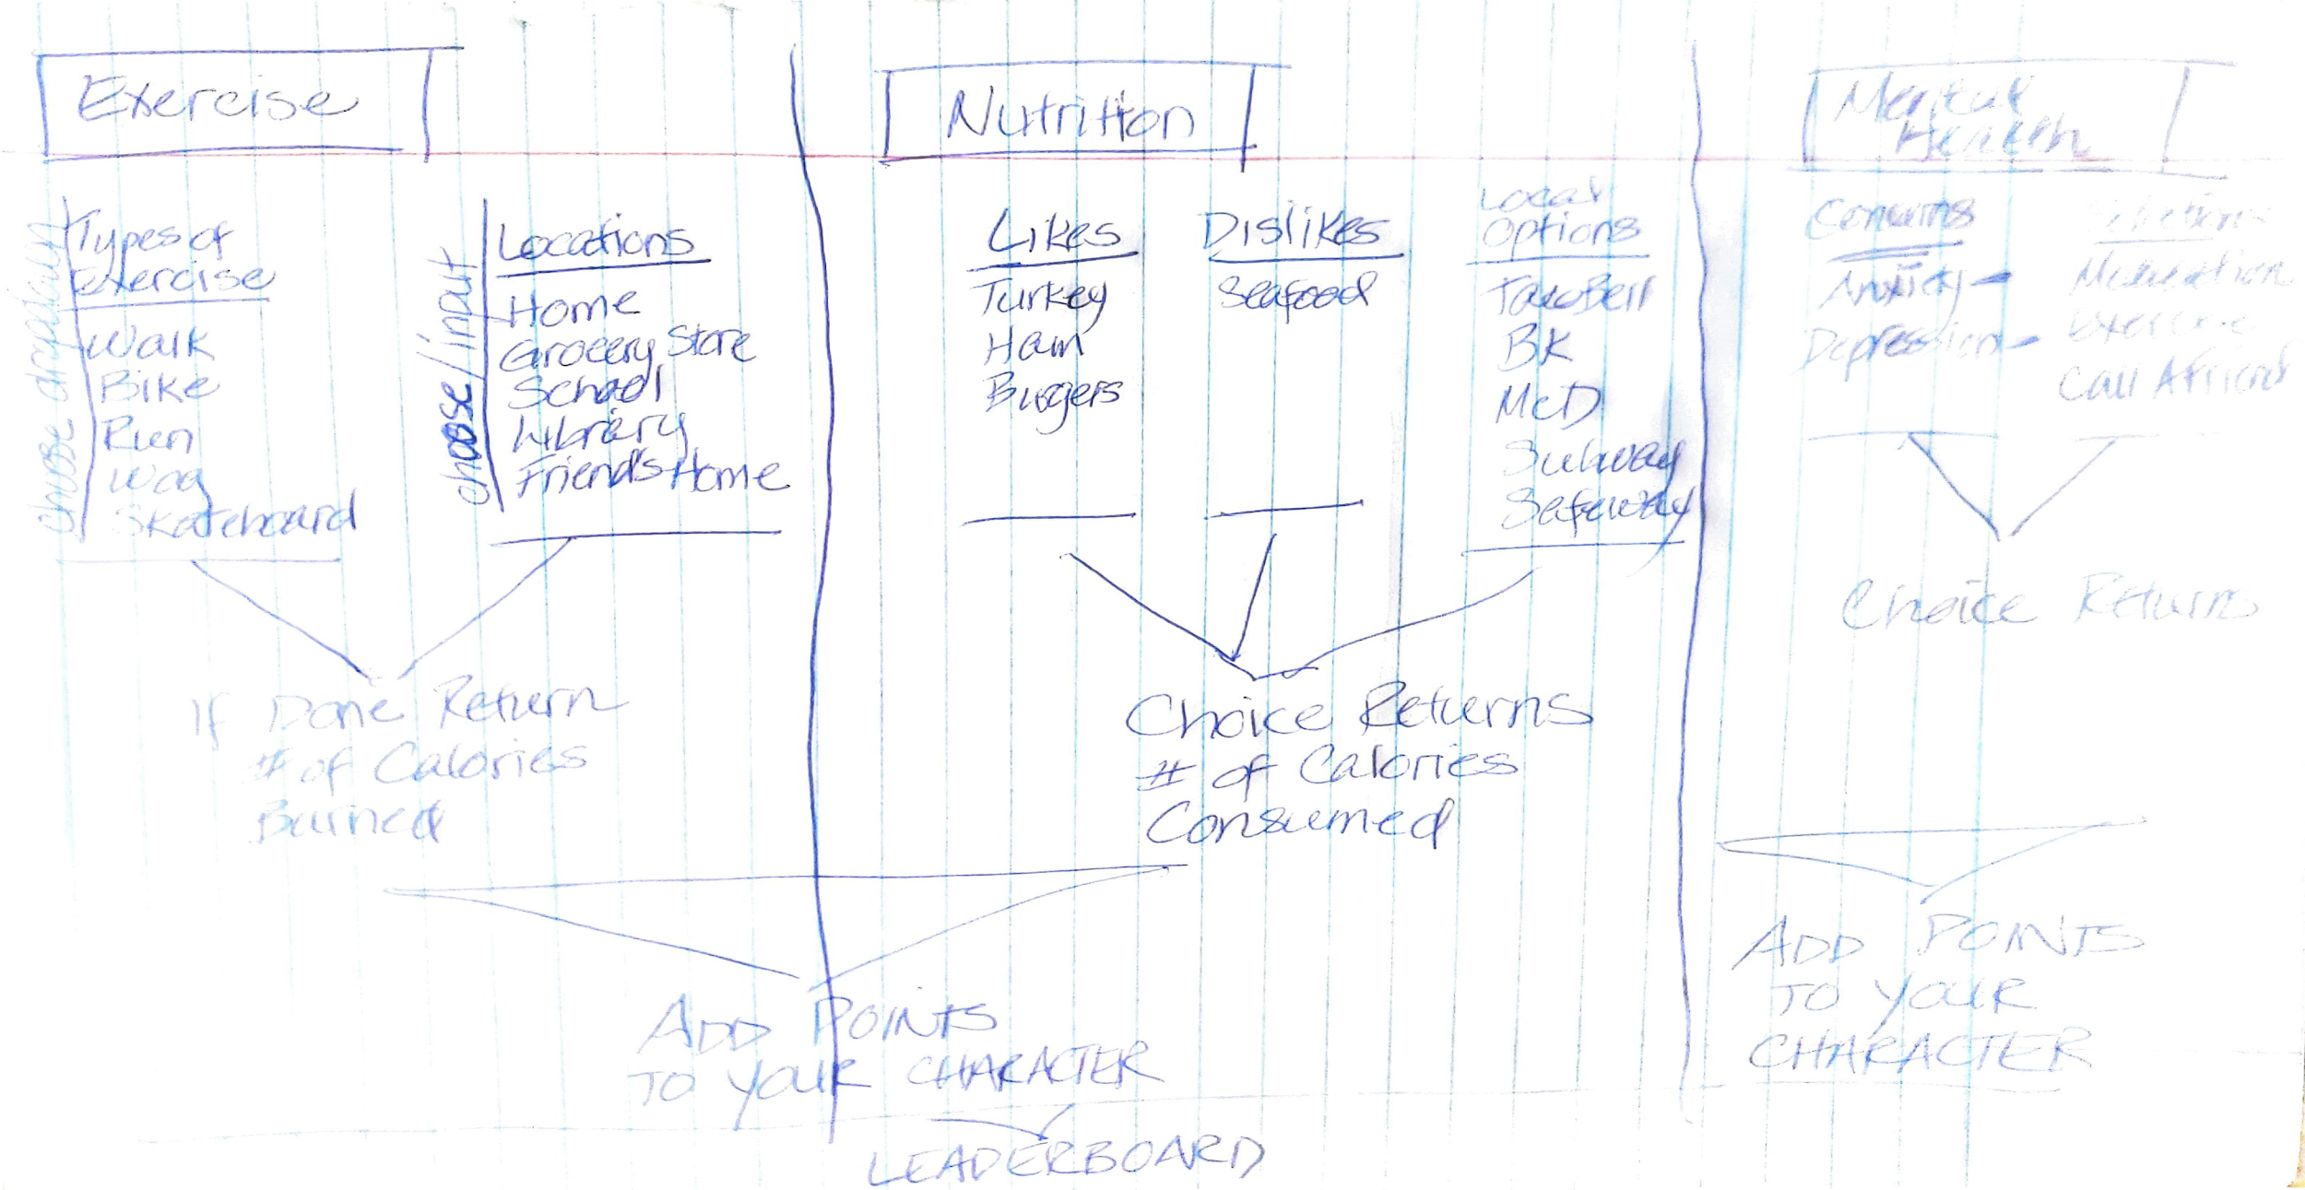
Initial Concept

Slide 15
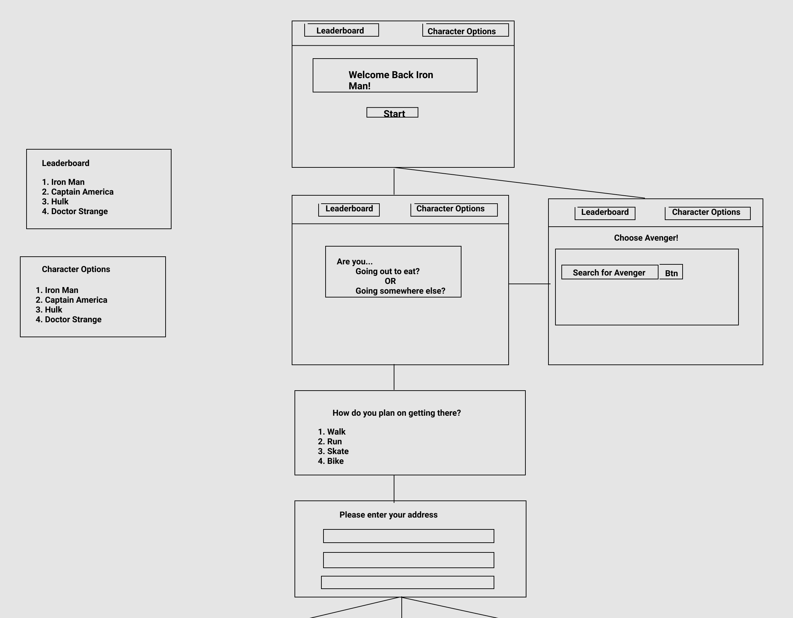
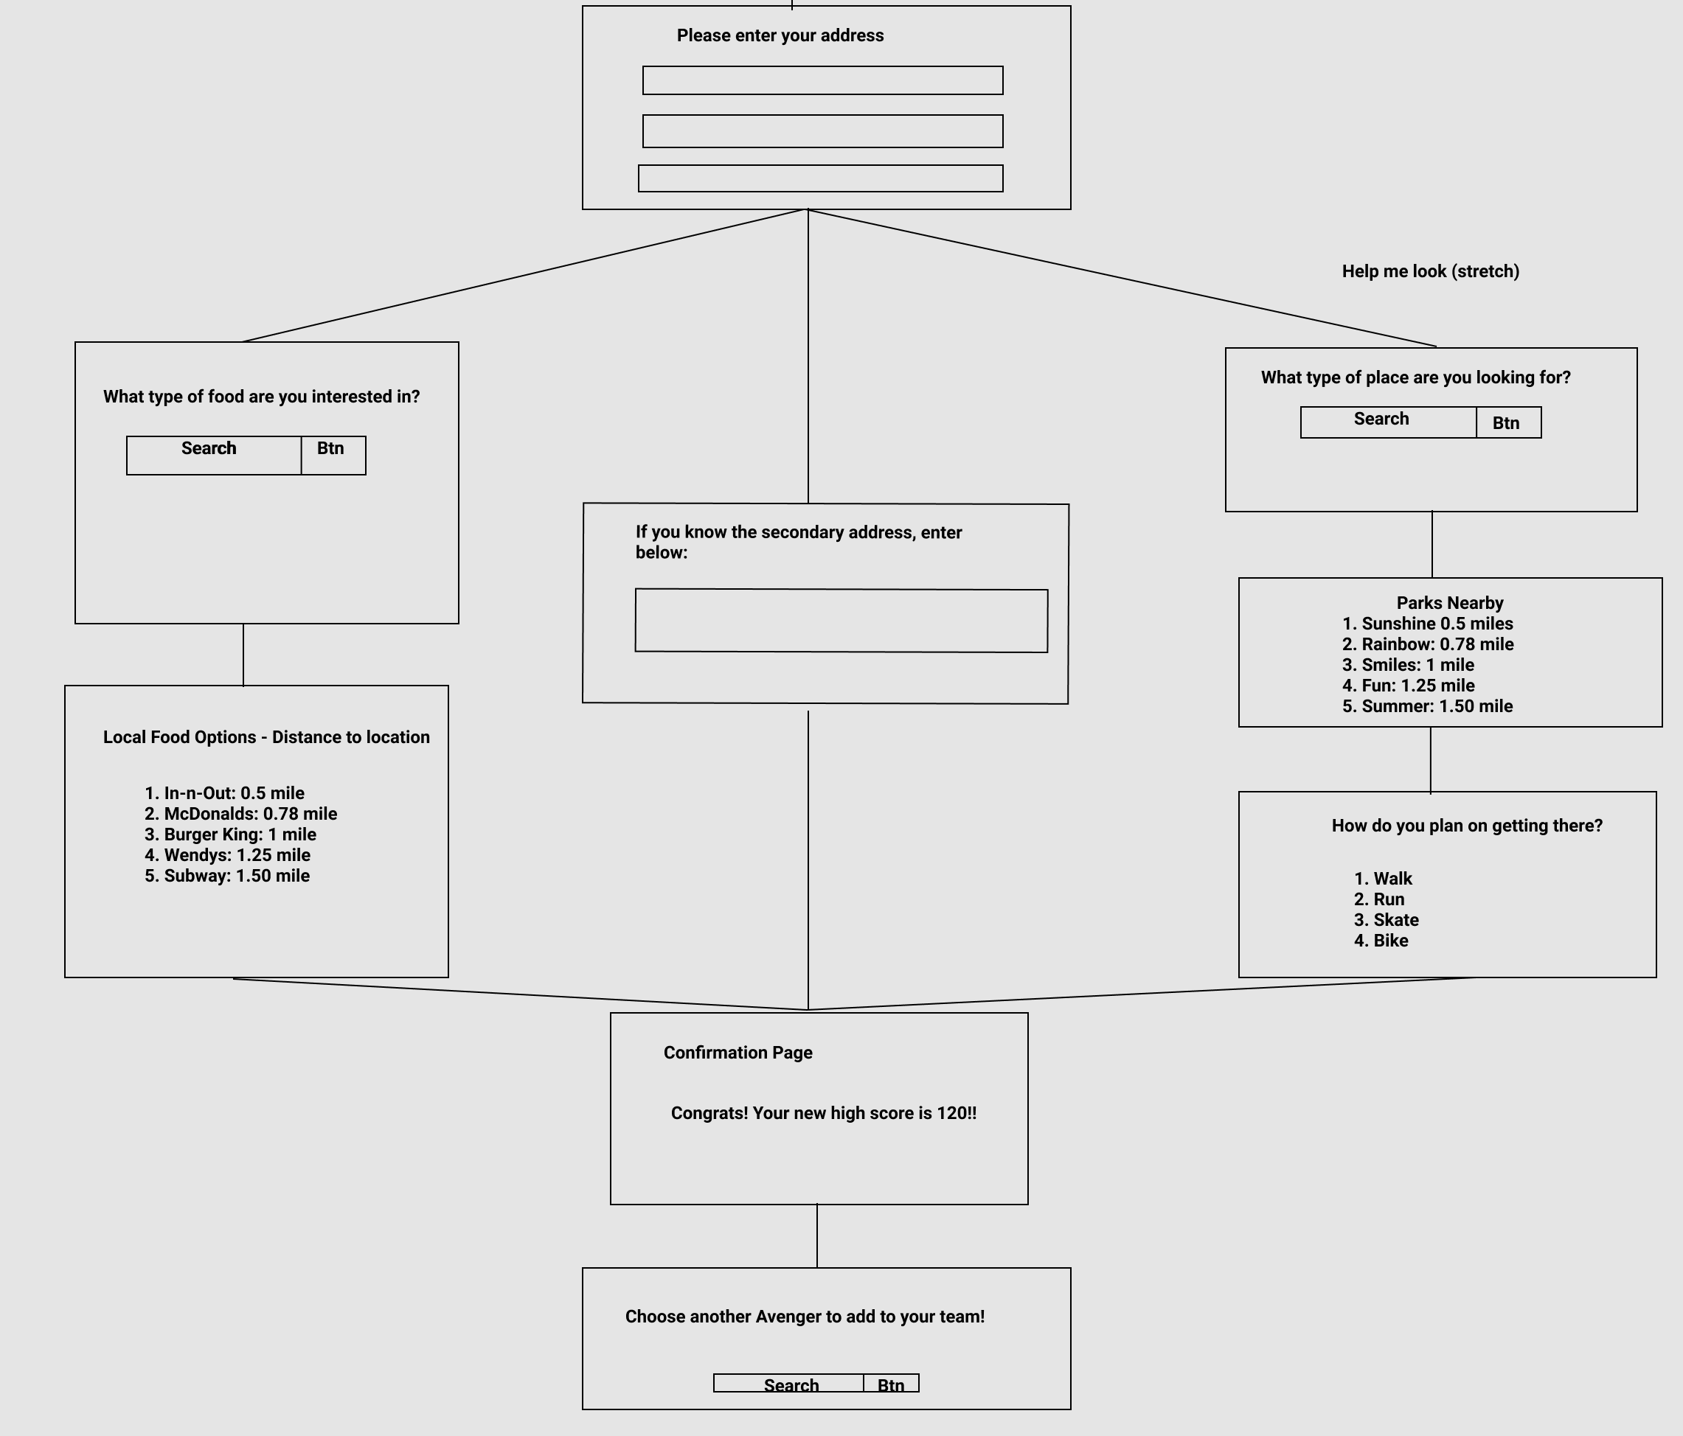
Planning Wireframe
Planning Wireframe
Side by Side of initial Wireframe vs. end product

Slide 16
End Product

Slide 17

MVP Goals
Landing Page Attractive User-friendly Clear purpose, ways to interact
User Profile User can choose a Marvel character as their avatar. Local storage determines new user vs returning user on visit. DOM greets avatar with personalized text and simple image(s).
User Interactivity * Users prompted to choose Grab A Healthy Meal or Get Active * Users prompted to choose mode of travel, Input start/end address * Choices & locations saved to local storage.
Key Functions * App gives tips for local healthy meals, exercise, other health * Award points for healthy choices. * Score displayed as score grows.

Slide 18
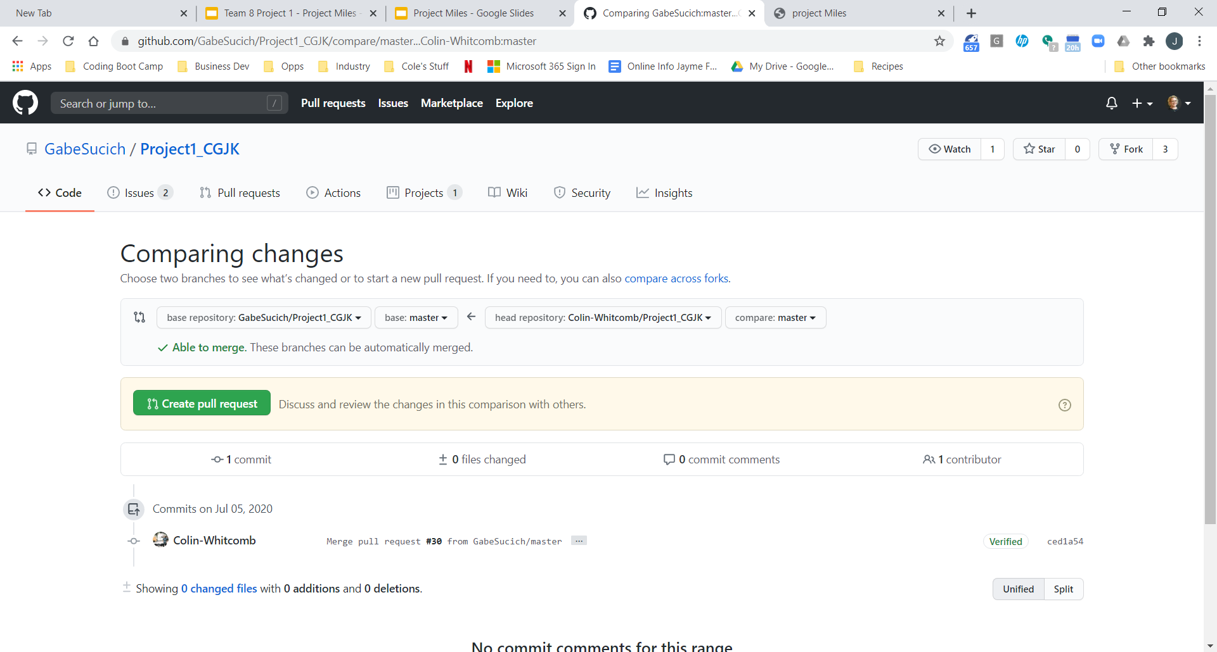
# Commits:
Master
200
Fork
Fork
Clone
Clone
Feature Branch
Feature Branch
Feature Branch
Feature Branch
Git Process
Git Issues?

Slide 19
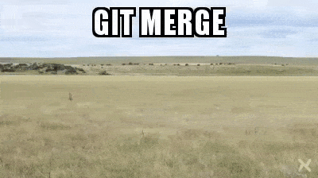
Github Issues

Slide 20
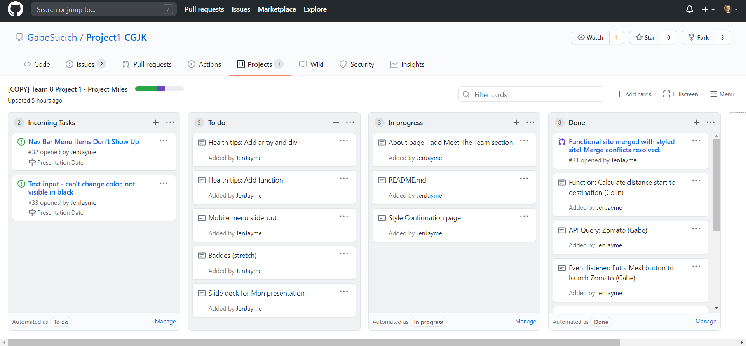
Kanban Board

Slide 21
Building the App and Demo
Gabe Sucich

Slide 22
Code Modules
Geocoder and OpenRoute APIs
Converts addresses to geocoordinates.
Route distance calculated from geocoordinates`of starting point and destination are
User Profile:
Stores user profile information in local storage
Stores user score in local storage
Sends any addresses input by use
Sends new points to update score
Geocoder and Zomato Restaurant
Converts current address to geocoordinates.
Finds nearby restaurants matching search query.
User Interaction:
Prompts the user about the nature of activity
Stores locations in local storage for future reference
Stores algorithm for calculating points earned
Sends user address and food preferences

Slide 23
Who Did What?
Roles & Task Assignments
Coding Lead & Scrum Master Code segment delegation Key code sections, DOM manipulation Zomato API Query | Gabe
Back End Lead & Git Branch expert TomTom API Queries & points calc Key javascript segments Confirmation screen | Colin
Front-End Lead HTML & CSS Styling, User Interaction Setup of loc, hero & health tip arrays Slide deck & kanban board | Jen

Slide 24

Team Process
Daily Meetings x2
Sessions often 1-2 hours
Merged the day’s work early then started with same version
Regular Slack Msgs

Slide 25
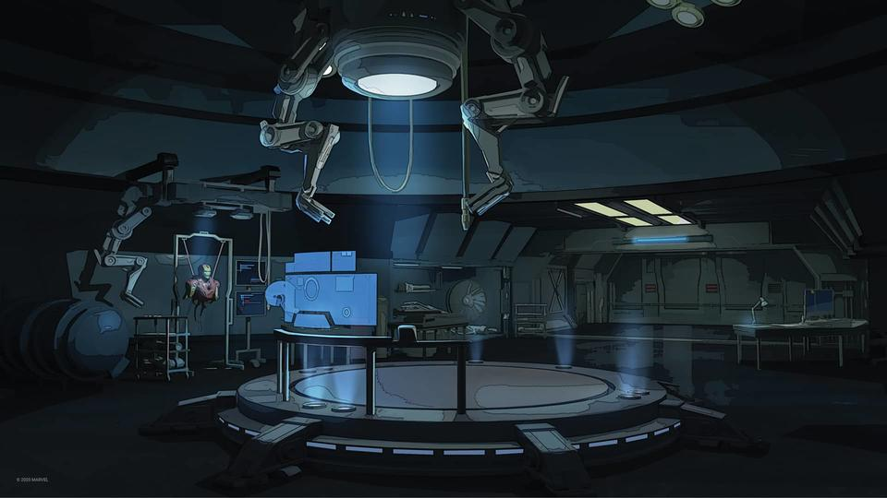
Built With:
Zomato (API)
Tom Tom (API)
Open Route (API)
Materialize (CSS)
Tabulator (TABLES)
Pivots:
Decided not to use Marvel API. For MVP, simplified to using an array of select heroes.
Decided to show/hide divs for prompts rather than use modals.

Slide 26
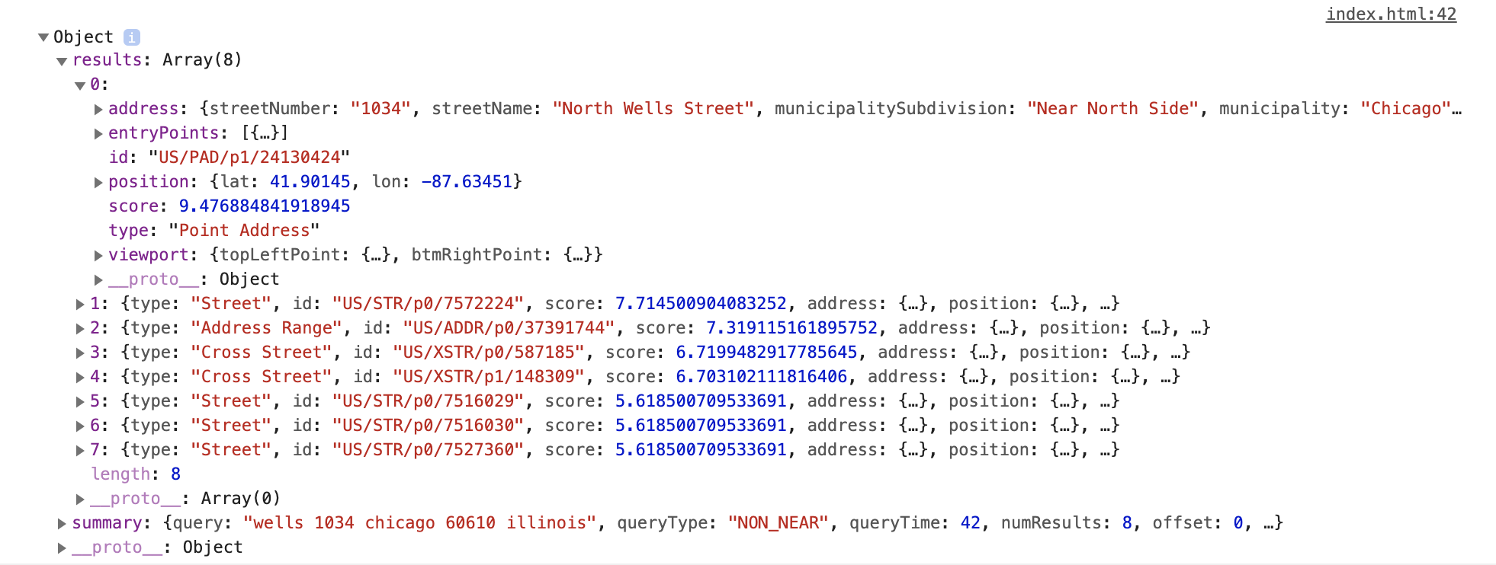
TomTom Geocoder API
https://api.tomtom.com/search/2/structuredGeocode.JSON?key=[api_key]&[address_info]

Slide 27
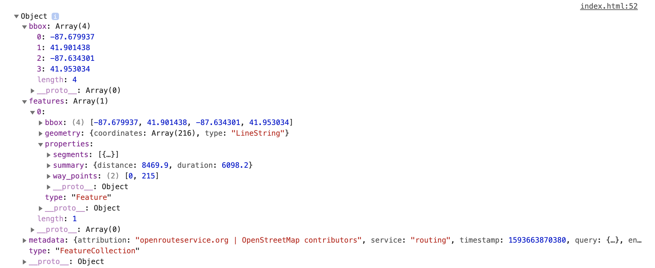
OpenRoute API
https://api.openrouteservice.org/v2/directions/foot-walking?api_key=[api_key]3&start=[coordinates]&end=[coordinates]

Slide 28
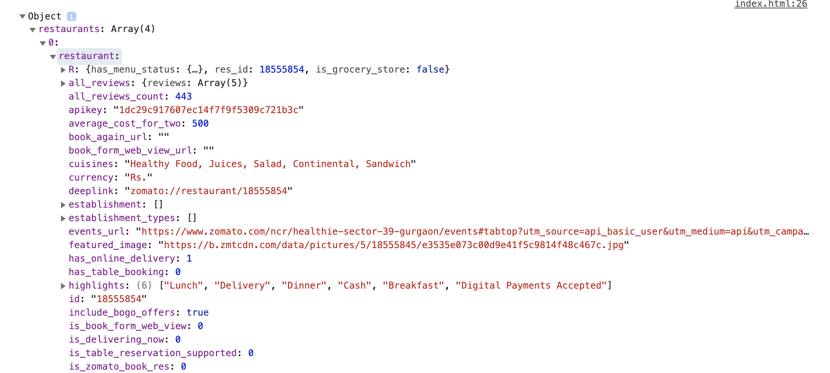
Zomato API
https://developers.zomato.com/api/v2.1/search?q=[food_query]&lat=[lat]&lon=[lon]&radius=[miles]

Slide 29
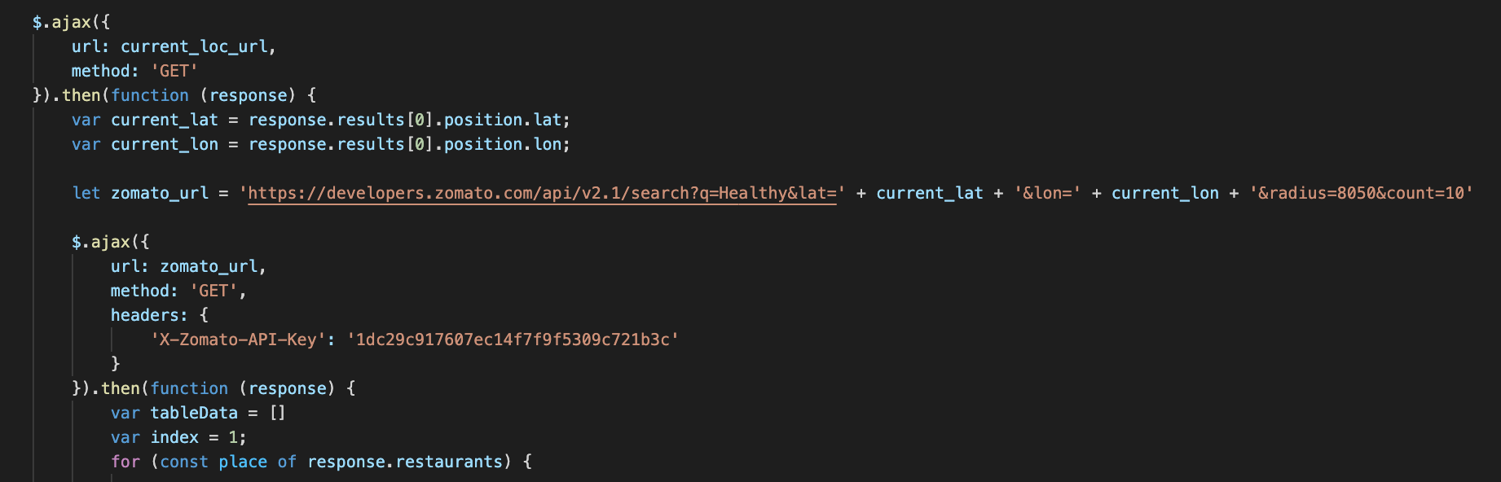
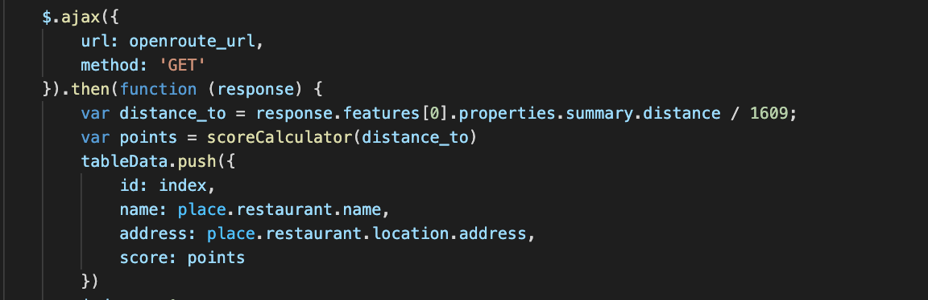
Code Snippets
API Nested Ajax Calls

Slide 30
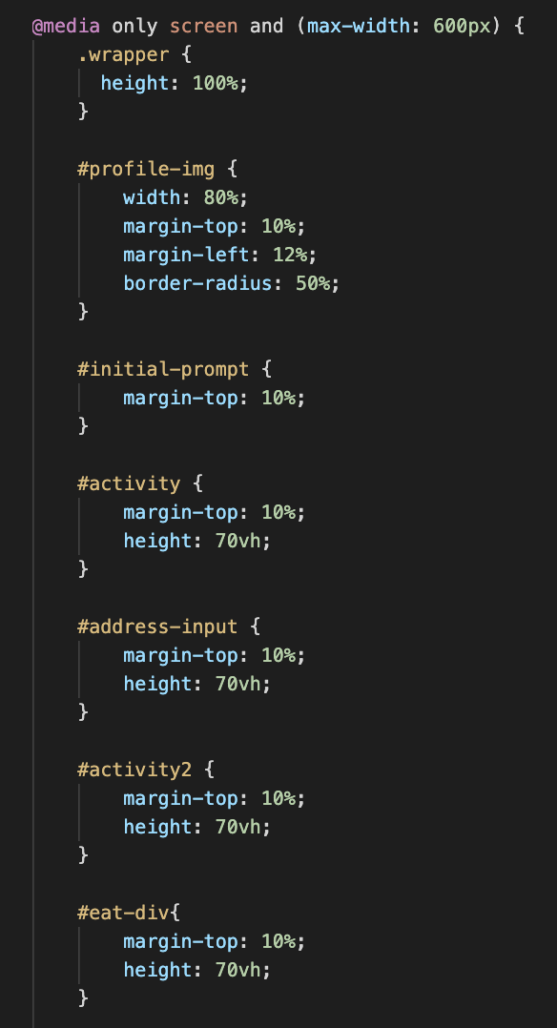
Code Snippets
Mobile Responsiveness
Sidebar disappears on your phone while answering key questions

Slide 31
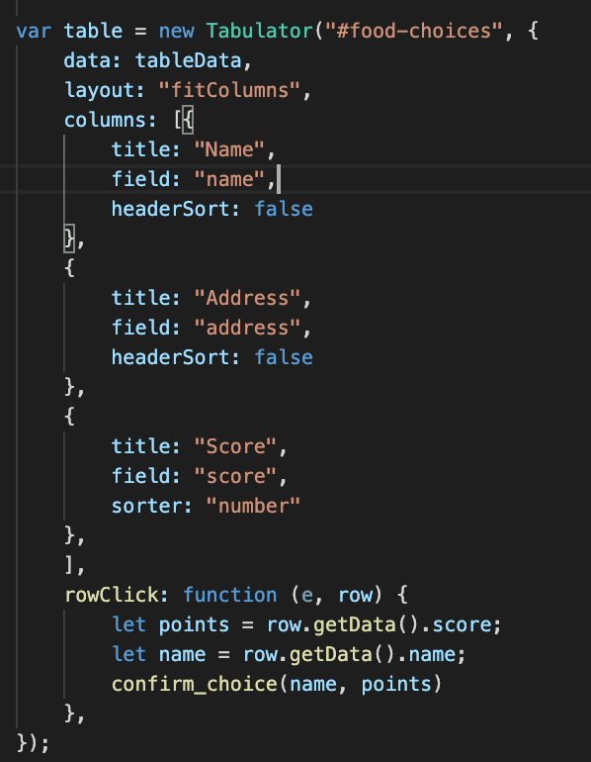
Code Snippets
Tabulator Libraryshows API query results in a user-friendly format

Slide 32
Tabulator

Slide 33

Materialize (CSS)

Slide 34
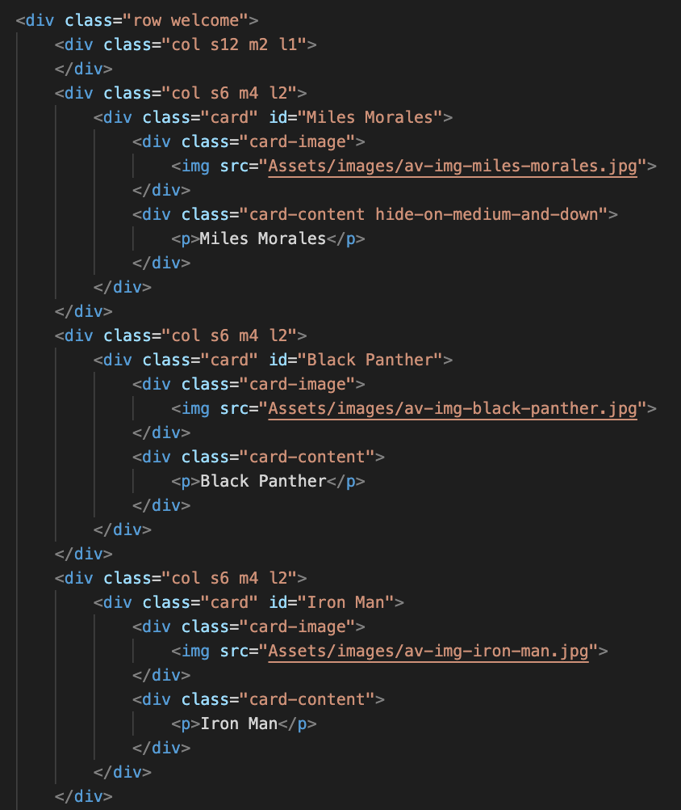
Code Snippets
Grid structure from Materialize
With divs for each screen

Slide 35
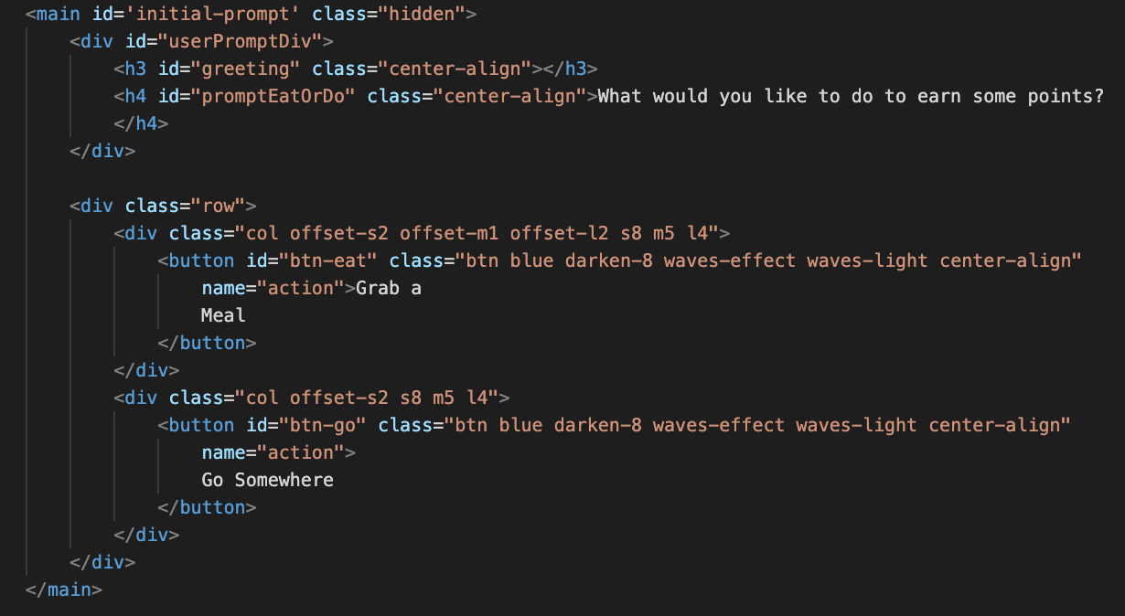
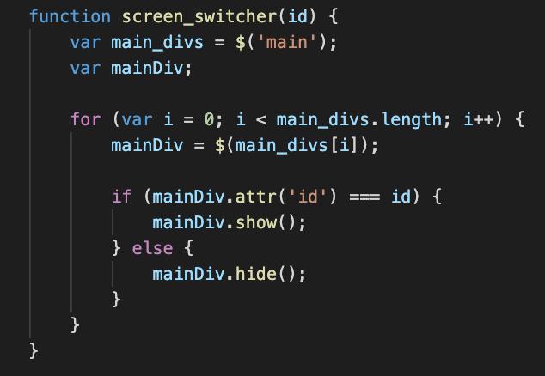
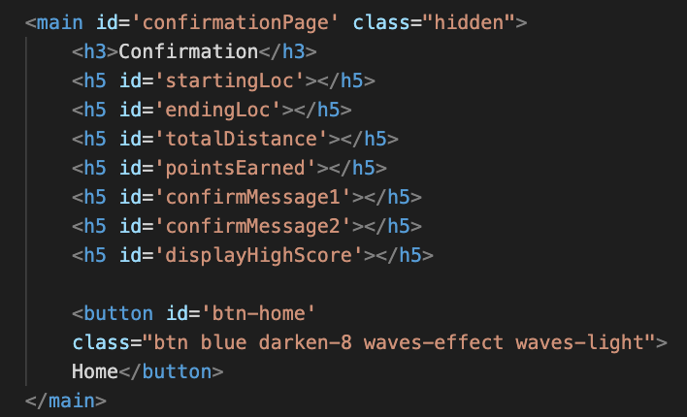
Code Snippets
Screen_Switcher Function
Shows and hides divs with element tag ‘Main’ for user prompts

Slide 36
Click logo to demo!

Slide 37
Future Dev
Leaderboard Scores of local users reflected on leaderboard.
Unlock New Characters Increased activity enables unlocking of new characters.
Challenges Users are presented with challenges both for characters and selves - e.g., health trivia and/or healthy actions.
Help Me Find… Function App helps user find a nearby park, hike, bike trail, and start and end addresses returned to function that calculates points for exercise
Mental Health Add mental health tips and resources to exercise and nutrition.
Social Media Add mental health tips and resources to exercise and nutrition.

Slide 38

Questions?

Slide 39
Healthy choices for teens, gamified.
Thank You!

Slide 40
Section
Header Template
Teammate
Name

